Slide 1
Deep Learning
UNIT-II
Deep Feed forward Networks: Learning XOR, Gradient-Based Learning, Hidden Units, Architecture Design, Back Propagation and Other Differentiation Algorithms.

Slide 2
Learning XOR
The XOR function is a binary function that takes two binary inputs and returns a binary output. The output is true if the number of true inputs is odd, and false otherwise. In other words, it returns true if exactly one of the inputs is true, and false otherwise.
Assuming the neural network is using sigmoid, relu or other linearly separation activation function, you need at least 2 layers to solve the XOR problem.

Slide 3
The XOR Problem
The XOR problem is that we need to build a Neural Network (a Perceptron in our case) to produce the truth table related to the XOR logical operator. This is a binary classification problem. Hence, supervised learning is a better way to solve it. In this case, we will be using Perceptrons. Uni layered perceptrons can only work with linearly separable data. But in the following diagram drawn in accordance with the truth table of the XOR logical operator, we can see that the data is NOT linearly separable.

Slide 4
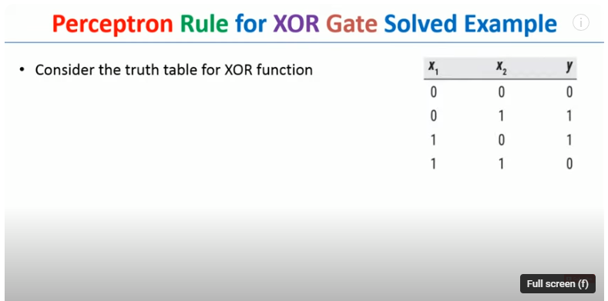
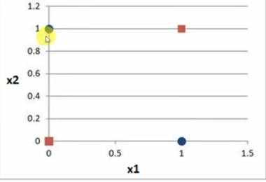
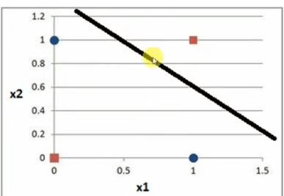
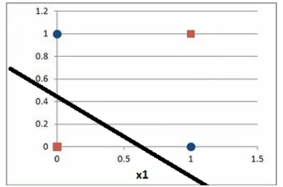

Slide 5
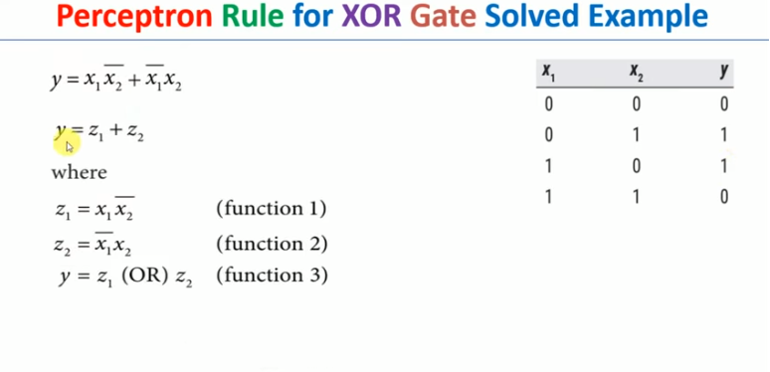
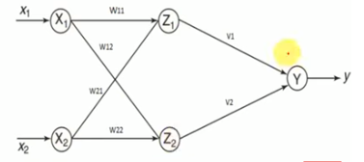

Slide 6
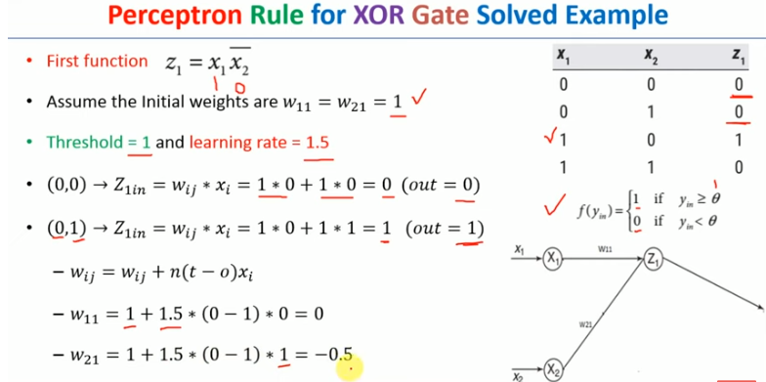

Slide 7
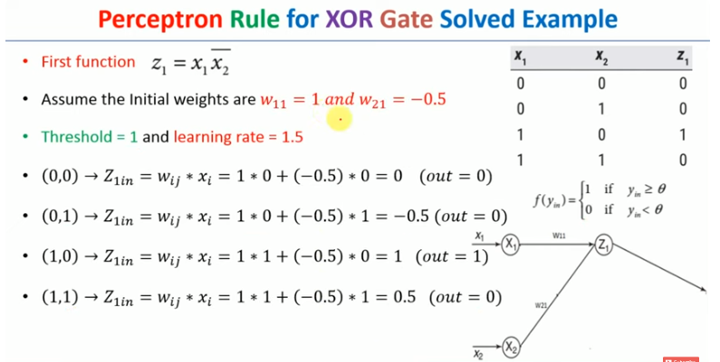

Slide 8
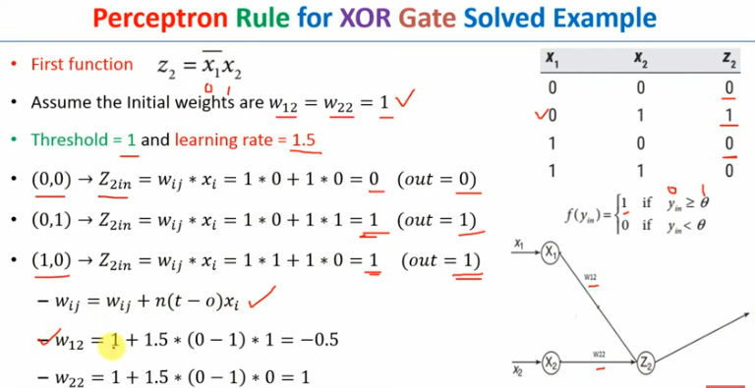

Slide 9
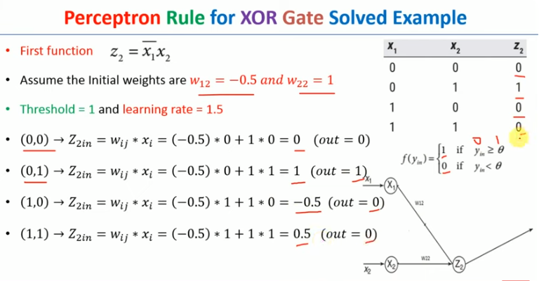

Slide 10
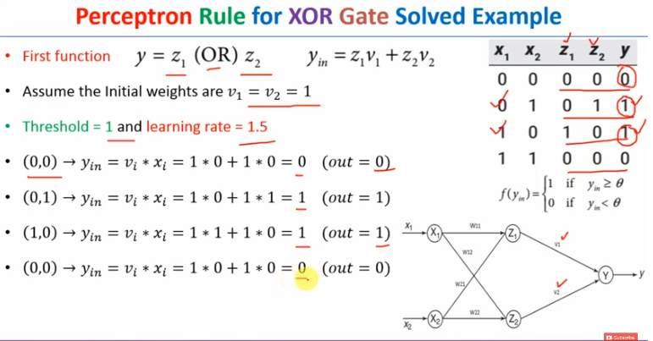

Slide 11
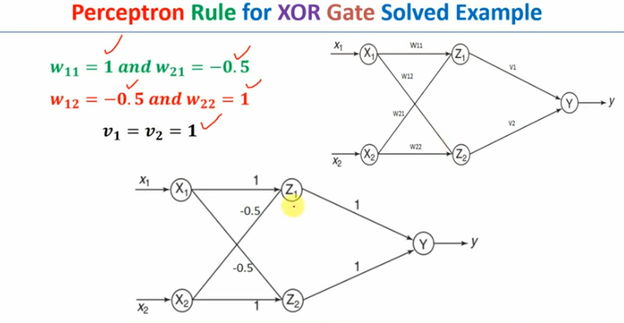

Slide 12
Gradient-Based Learning
Gradient Descent is known as one of the most commonly used optimization algorithms to train machine learning models by means of minimizing errors between actual and expected results. Further, gradient descent is also used to train Neural Networks.
In mathematical terminology, Optimization algorithm refers to the task of minimizing/maximizing an objective function f(x) parameterized by x.
The main objective of gradient descent is to minimize the cost function or the error between expected and actual

Slide 13
Similarly, in machine learning, optimization is the task of minimizing the cost function parameterized by the model's parameters.
The main objective of gradient descent is to minimize the convex function using iteration of parameter updates.
Once these machine learning models are optimized, these models can be used as powerful tools for Artificial Intelligence and various computer science applications.

Slide 14
Gradient Descent is defined as one of the most commonly used iterative optimization algorithms of machine learning to train the machine learning and deep learning models. It helps in finding the local minimum of a function.
If we move towards a negative gradient or away from the gradient of the function at the current point, it will give the local minimum of that function.
Whenever we move towards a positive gradient or towards the gradient of the function at the current point, we will get the local maximum of that function.

Slide 15
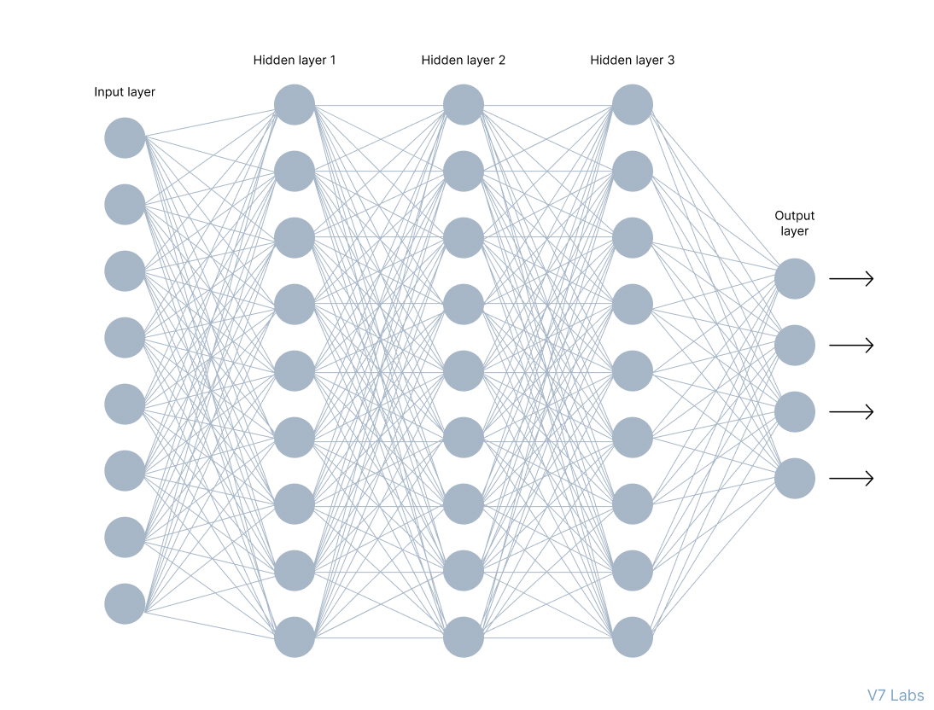

Slide 16
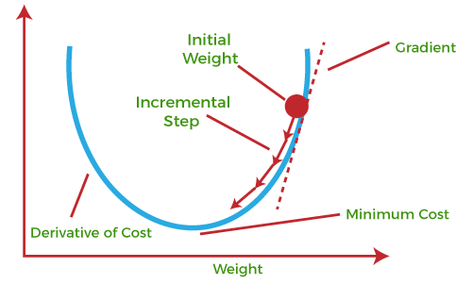

Slide 17
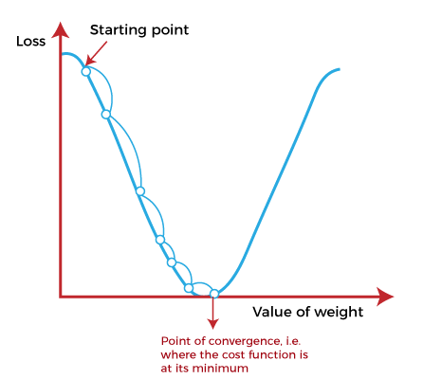

Slide 18
This entire procedure is known as Gradient Ascent, which is also known as steepest descent. The main objective of using a gradient descent algorithm is to minimize the cost function using iteration. To achieve this goal, it performs two steps iteratively:
Calculates the first-order derivative of the function to compute the gradient or slope of that function.
Move away from the direction of the gradient, which means slope increased from the current point by alpha times, where Alpha is defined as Learning Rate. It is a tuning parameter in the optimization process which helps to decide the length of the steps.

Slide 19
Cost function
The cost function is defined as the measurement of difference or error between actual values and expected values at the current position and present in the form of a single real number.
It helps to increase and improve machine learning efficiency by providing feedback to this model so that it can minimize error and find the local or global minimum. Further, it continuously iterates along the direction of the negative gradient until the cost function approaches zero. At this steepest descent point, the model will stop learning further.

Slide 20
Types of Gradient Descent
1. Batch Gradient Descent:
Batch gradient descent (BGD) is used to find the error for each point in the training set and update the model after evaluating all training examples. This procedure is known as the training epoch. In simple words, it is a greedy approach where we have to sum over all examples for each update.

Slide 21
2. Stochastic gradient descent
Stochastic gradient descent (SGD) is a type of gradient descent that runs one training example per iteration. Or in other words, it processes a training epoch for each example within a dataset and updates each training example's parameters one at a time. As it requires only one training example at a time, hence it is easier to store in allocated memory. However, it shows some computational efficiency losses in comparison to batch gradient systems as it shows frequent updates that require more detail and speed.

Slide 22
Mini Batch Gradient Descent:
Mini Batch gradient descent is the combination of both batch gradient descent and stochastic gradient descent. It divides the training datasets into small batch sizes then performs the updates on those batches separately. Splitting training datasets into smaller batches make a balance to maintain the computational efficiency of batch gradient descent and speed of stochastic gradient descent. Hence, we can achieve a special type of gradient descent with higher computational efficiency and less noisy gradient descent.

Slide 23
Hidden Units
In deep learning, hidden units refer to the neurons or nodes in a neural network that are not part of the input or output layers.
These hidden units play a crucial role in the network's ability to learn complex representations and relationships within the data.
A neural network consists of layers of interconnected nodes. The input layer receives the raw data, the output layer produces the final predictions or classifications, and the hidden layers, if present, process the information through a series of mathematical transformations.

Slide 24
The term "hidden" arises because the values in these layers are not directly observed or interpreted in the context of the input or output data. During the training process, the network adjusts the weights associated with these hidden units to learn and capture the underlying patterns in the data.
The architecture, including the number of layers and hidden units, can significantly impact the model's performance, training time, and ability to capture complex relationships in the data.

Slide 25
Choosing the right number of hidden units involves a trade-off. Too few hidden units might result in the network being unable to capture complex patterns, while too many hidden units can lead to overfitting, where the model performs well on the training data but fails to generalize to new, unseen data.
Experimenting with different architectures and hyperparameters, such as the number of hidden units, is a common practice in deep learning to find the optimal configuration for a specific task.

Slide 26
Activation function
The way hidden units are differentiated from each other is based on their activation function, g(z):
ReLU
ELU
GELU
Maxout
PReLU
Absolute value rectification
LeakyReLU
Logistic Sigmoid
Hyperbolic Tangent
Hard Hyperbolic Tangent
Identity
Softplus
Softmax
RBF

Slide 27
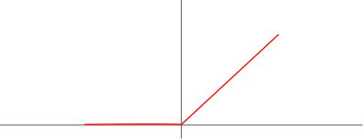
Rectified Linear Unit
The Rectified Linear Unit is the most commonly used activation function in deep learning models. The function returns 0 if it receives any negative input, but for any positive value x it returns that value back
f(x)=max(0,x).

Slide 28

Exponential Linear Unit (ELU)
The Exponential Linear Unit or ELU is a function that tends to converge faster and produce more accurate results. Unlike other activation functions, ELU has an extra alpha constant which should be a positive number. ELU is very similar to ReLU except for negative inputs.

Slide 29

Gaussian Error Linear Units (GELUs),
GELU is derived from a smooth approximation of the cumulative distribution function (CDF) of the standard normal distribution. It is our input times the standard normal CDF at that point:

Slide 30
Architecture Design
The number of architectures and algorithms that are used in deep learning is wide and varied. This section explores six of the deep learning architectures spanning the past 20 years. Notably, long short-term memory (LSTM) and convolutional neural networks (CNNs) are two of the oldest approaches in this list but also two of the most used in various applications.

Slide 31
Connectionist architectures have existed for more than 70 years, but new architectures and graphical processing units (GPUs) brought them to the forefront of artificial intelligence. Deep learning isn't a single approach but rather a class of algorithms and topologies that you can apply to a broad spectrum of problems.

Slide 32
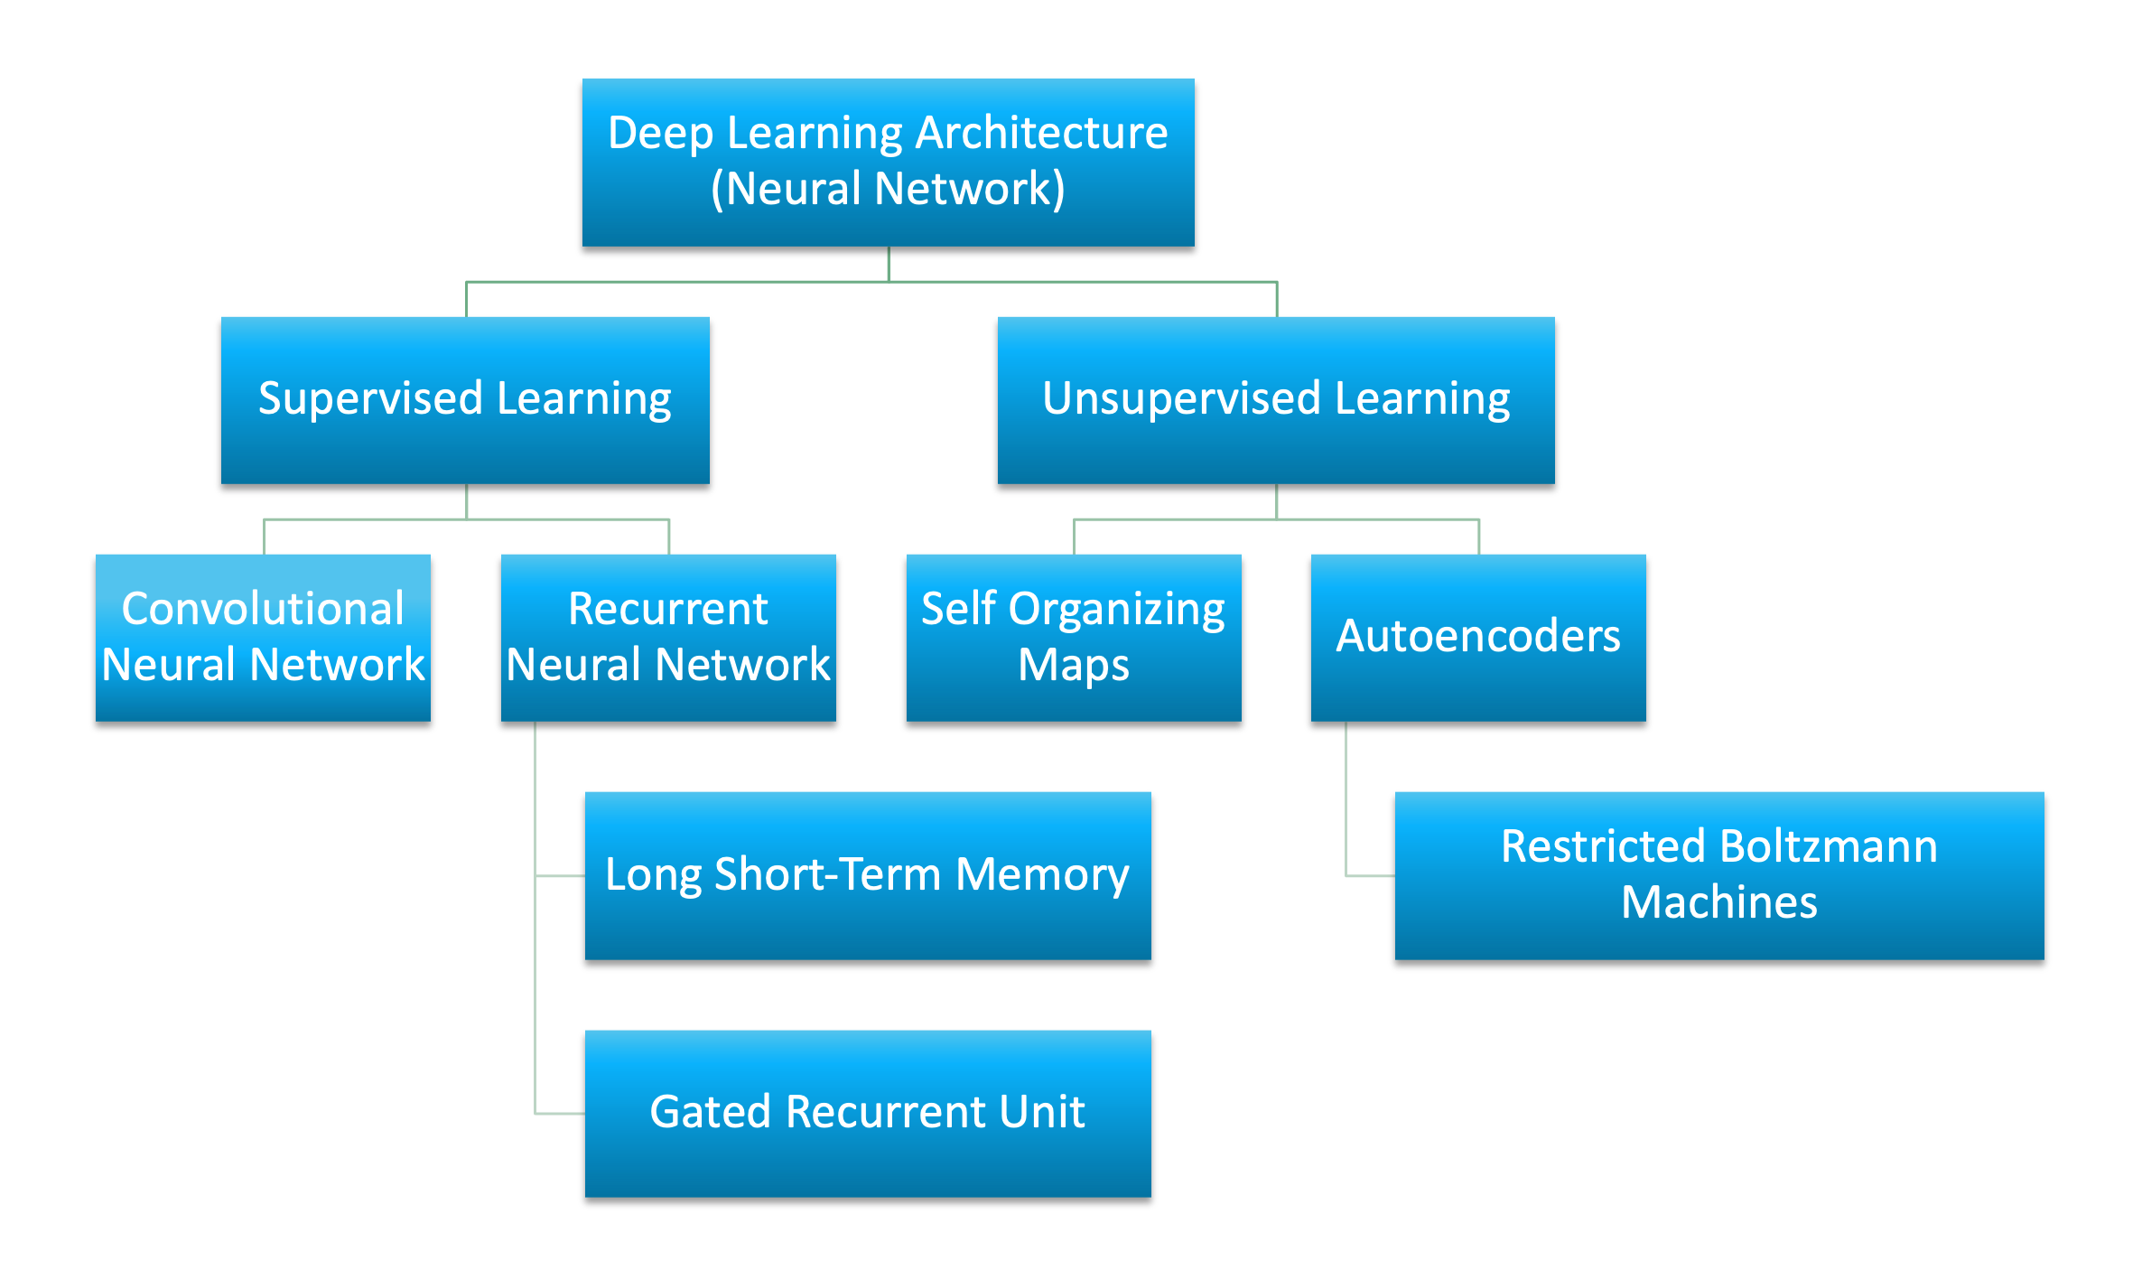

Slide 33
Neural Networks (CNNs): These are commonly used for image and video recognition tasks. They are designed to automatically and adaptively learn spatial hierarchies of features from input images ¹.
Recurrent Neural Networks (RNNs): These are used for processing sequential data such as text and speech. They are designed to capture temporal dependencies in the data by using feedback connections

Slide 34
Long Short-Term Memory (LSTM) Networks: These are a type of RNN that are designed to address the vanishing gradient problem that can occur when training deep neural networks. They are commonly used for natural language processing tasks
Autoencoders: These are neural networks that are trained to reconstruct their input data. They can be used for tasks such as image denoising, dimensionality reduction, and anomaly detection

Slide 35
UNIT-III
Regularization for Deep Learning: Parameter Norm Penalties, Early Stopping, Dropout; Optimization for Training Deep Models: How Learning Differs from Pure Optimization, Challenges, Basic Algorithms, Parameter Initialization Strategies, Algorithms with Adaptive Learning Rates, Optimization Strategies and Meta-Algorithms.

Slide 36
Regularization in Deep Learning
While developing Deep learning models you must have encountered a situation in which the training accuracy of the model is low but the validation accuracy or the testing accuracy is too low. This is the case which is popularly known as overfitting in the domain of machine learning also this is the last thing a Deep learning practitioner would like to have in his model. In this situation , we will learn about a method known as regularization which helps us to solve the problem of overfitting. But before that let’s understand what is underfitting and overfitting.

Slide 37
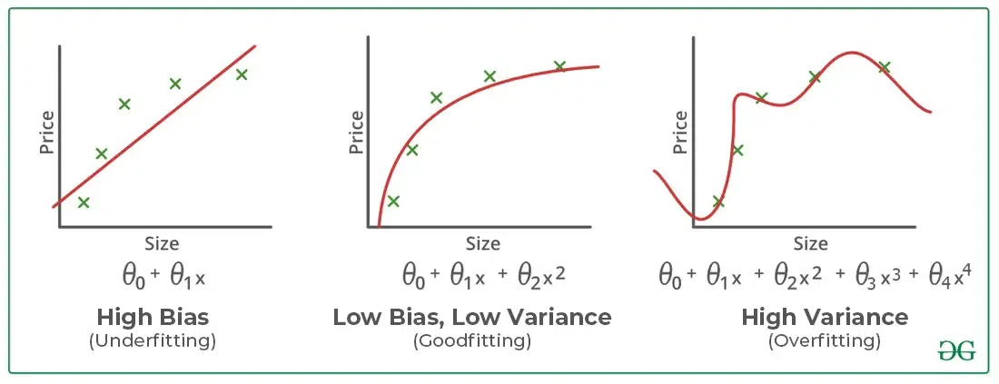

Slide 38
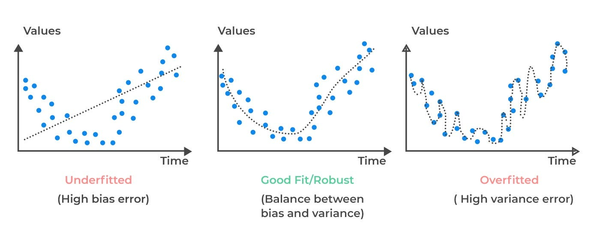

Slide 39
Regularization is one of the most important concepts of Deep learning. It is a technique to prevent the model from overfitting by adding extra information to it.
Sometimes the Deep learning model performs well with the training data but does not perform well with the test data. It means the model is not able to predict the output when deals with unseen data by introducing noise in the output, and hence the model is called overfitted. This problem can be deal with the help of a regularization technique.

Slide 40
This technique can be used in such a way that it will allow to maintain all variables or features in the model by reducing the magnitude of the variables. Hence, it maintains accuracy as well as a generalization of the model.
It mainly regularizes or reduces the coefficient of features toward zero. In simple words, "In regularization technique, we reduce the magnitude of the features by keeping the same number of features."

Slide 41
How does Regularization Work?
Regularization works by adding a penalty or complexity term to the complex model. Let's consider the simple linear regression equation:
y= β0+β1x1+β2x2+β3x3+⋯+βnxn +b
In the above equation, Y represents the value to be predicted
X1, X2, …Xn are the features for Y.
β0,β1,…..βn are the weights or magnitude attached to the features, respectively. Here represents the bias of the model, and b represents the intercept.

Slide 42
Linear regression models try to optimize the β0 and b to minimize the cost function. The equation for the cost function for the linear model is given below:
Now, we will add a loss function and optimize parameter to make the model that can predict the accurate value of Y. The loss function for the linear regression is called as RSS or Residual sum of squares.

Slide 43
Techniques of Regularization
here are mainly two types of regularization techniques, which are given below:
Ridge Regression
Lasso Regression
Ridge Regression
Ridge regression is one of the types of linear regression in which a small amount of bias is introduced so that we can get better long-term predictions.

Slide 44

In this technique, the cost function is altered by adding the penalty term to it. The amount of bias added to the model is called Ridge Regression penalty. It is L2 Regularization technique. We can calculate it by multiplying with the lambda to the squared weight of each individual feature.
The equation for the cost function in ridge regression will be:

Slide 45
In the above equation, the penalty term regularizes the coefficients of the model, and hence ridge regression reduces the amplitudes of the coefficients that decreases the complexity of the model.
As we can see from the above equation, if the values of λ tend to zero, the equation becomes the cost function of the linear regression model. Hence, for the minimum value of λ, the model will resemble the linear regression model.

Slide 46
A general linear or polynomial regression will fail if there is high collinearity between the independent variables, so to solve such problems, Ridge regression can be used.
It helps to solve the problems if we have more parameters than samples.

Slide 47
Lasso Regression:
Lasso regression is another regularization technique to reduce the complexity of the model. It stands for Least Absolute and Selection Operator.
It is similar to the Ridge Regression except that the penalty term contains only the absolute weights instead of a square of weights.
Since it takes absolute values, hence, it can shrink the slope to 0, whereas Ridge Regression can only shrink it near to 0.

Slide 48

It is also called as L1 regularization. The equation for the cost function of Lasso regression will be:
Some of the features in this technique are completely neglected for model evaluation.
Hence, the Lasso regression can help us to reduce the overfitting in the model as well as the feature selection.

Slide 49
Elastic Net regularization essentially combines both ridge and lasso regression but inserting both the L1 and L2 penalty terms into the SSE loss function. L2 and L1 derive their penalty term value, respectively, by squaring or taking the absolute value of the sum of the feature weights. Elastic net inserts both of these penalty values into the cost function (SSE) equation. In this way, elastic net addresses multicollinearity while also enabling feature selection.

Slide 50
Parameter Norm Penalties
Regularization has been used for decades prior to the advent of deep learning. Linear models such as linear regression and logistic regression allow simple, straightforward, and effective regularization strategies.
Parameter Norm Penalties are regularization methods that apply a penalty to the norm of parameters in the objective function of a neural network. Below you can find a continuously updating list of parameter norm penalties.

Slide 51

Weight Decay
Weight Decay or L2 Regularization, is a regularization technique applied to the weights of a neural network. We minimize a loss function compromising both the primary loss function and a penalty on the L2 Norm of the weights:
where λ is a value determining the strength of the penalty (encouraging smaller weights).

Slide 52
Weight decay can be incorporated directly into the weight update rule, rather than just implicitly by defining it through to objective function. Often weight decay refers to the implementation where we specify it directly in the weight update rule (whereas L2 regularization is usually the implementation which is specified in the objective function).

Slide 53

L1Regularization
L1 Regularization is a regularization technique applied to the weights of a neural network. We minimize a loss function compromising both the primary loss function and a penalty on the L1 Norm of the weights:
where λ is a value determining the strength of the penalty. In contrast to weight decay, L1 regularization promotes sparsity; i.e. some parameters have an optimal value of zero.

Slide 54
Early Stopping
In Deep learning, early stopping is a form of regularization used to avoid overfitting when training a learner with an iterative method, such as gradient descent. Such methods update the learner so as to make it better fit the training data with each iteration.

Slide 55
In Regularization by Early Stopping, we stop training the model when the performance on the validation set is getting worse- increasing loss decreasing accuracy, or poorer scores of the scoring metric. By plotting the error on the training dataset and the validation dataset together, both the errors decrease with a number of iterations until the point where the model starts to overfitting. After this point, the training error still decreases but the validation error increases.

Slide 56
So, even if training is continued after this point, early stopping essentially returns the set of parameters that were used at this point and so is equivalent to stopping training at that point. So, the final parameters returned will enable the model to have low variance and better generalization. The model at the time the training is stopped will have a better generalization performance than the model with the least training error.

Slide 57
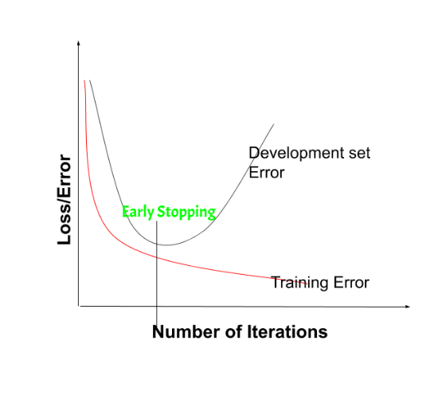

Slide 58
Early stopping can be thought of as implicit regularization, contrary to regularization via weight decay. This method is also efficient since it requires less amount of training data, which is not always available. Due to this fact, early stopping requires lesser time for training compared to other regularization methods. Repeating the early stopping process many times may result in the model overfitting the validation dataset, just as similar as overfitting occurs in the case of training data.

Slide 59
The number of iterations(i.e. epoch) taken to train the model can be considered a hyperparameter. Then the model has to find an optimum value for this hyperparameter (by hyperparameter tuning) for the best performance of the learning model.
Benefits of Early Stopping:
Helps in reducing overfitting
It improves generalisation
It requires less amount of training data
Takes less time compared to other regularisation models
It is simple to implement

Slide 60
Optimization for Training Deep Models
How Learning Differs from Pure Optimization,
Challenges,
Basic Algorithms,
Parameter Initialization Strategies,
Algorithms with Adaptive Learning Rates,
Optimization Strategies and
Meta-Algorithms.

Slide 61
While training the deep learning optimizers model, modify each epoch's weights and minimize the loss function. An optimizer is a function or an algorithm that adjusts the attributes of the neural network, such as weights and learning rates. Thus, it helps in reducing the overall loss and improving accuracy.

Slide 62
Training deep models, especially deep neural networks, involves numerous challenges including computational complexity, overfitting, vanishing/exploding gradients, and optimization difficulties. Here are some optimization techniques commonly used to address these challenges:
Mini-batch Stochastic Gradient Descent (SGD): Instead of computing the gradient of the entire dataset, mini-batch SGD computes the gradient on a small random subset (mini-batch) of the dataset. This approach reduces computational requirements and noise that helps avoid local minima.

Slide 63
Learning Rate Scheduling: Adjusting the learning rate during training can help in convergence and avoiding divergence. Techniques like step decay, exponential decay, and adaptive methods like Adam, RMSprop, or AdaGrad dynamically adjust the learning rate based on past gradients.
Weight Initialization: Initializing the weights of the network appropriately is crucial for convergence. Initialization are commonly used to ensure that the weights are neither too large nor too small, preventing to reduce the overfitting.

Slide 64
Batch Normalization: Batch normalization normalizes the inputs of each layer, which helps stabilize and speed up the training process. It reduces the internal covariate shift and can mitigate the exploding gradient problem.
Regularization: Techniques like L1/L2 regularization, dropout, and early stopping help prevent overfitting. Regularization adds penalties to the loss function to discourage large weights and complex models.

Slide 65
Hyperparameter Optimization: Tuning hyperparameters like learning rate, batch size, dropout rate, etc., using techniques like grid search, random search, or Bayesian optimization, can help find optimal settings for training.
Transfer Learning: Utilizing pre-trained models and fine-tuning them on your specific task can significantly reduce training time and data requirements, especially when dealing with limited labeled data.

Slide 66
Data Augmentation: Increasing the diversity of the training data by applying transformations like rotation, translation, flipping, or scaling can help generalize the model and reduce overfitting.
Gradient Clipping: Limiting the norm of the gradients during training helps prevent exploding gradient problems, especially in recurrent neural networks.

Slide 67
How Learning Differs from Pure Optimization
Optimization algorithms used for training of deep models differ from traditional optimization algorithms in several ways.
Machine learning usually acts indirectly.
In most machine learning scenarios, we care about some performance measure P, therefore optimize P only indirectly. We reduce a cost function J(θ) indirectly so will improve P. This is in contrast to pure optimization, where minimizing J(θ).

Slide 68
Machine Learning usually acts indirectly for optimization i.e., uses training dataset.
Most of the machine learning algorithms use some performance measure P that is defined w.r.t the test set and may also ne intractable (not easily managed or control).
Improve the metric P by reducing the error using cost function J(θ).
It is achieved by updating the parameters during optimization.
But it is in contrast to pure optimization.

Slide 69
Pure optimization goal is minimizing J(θ) directly that based on true dataset.
Eg., Compute the height of the Indian people.
True data – Nation wide population
True risk – loss calculated from true data (distribution of the data is not known priory)
Training data – Set of people considered across India
Empirical Risk- Loss calculated from training data. The Empirical Risk Minimization (ERM) principle is a learning paradigm which consists in selecting the model with minimal average error over the training set

Slide 70
Other Differential Algorithms
In addition to backpropagation, which is the most commonly used algorithm for training neural networks, there are several other algorithms and techniques used in deep learning for optimization, regularization, and model improvement. Here are some notable ones:
Stochastic Gradient Descent(SGD): SGD is a variant of gradient descent whare the model parameters are updated using the gradient of the loss with respect to the parameters, but only on a small subset (Mini Batch) of the training data at a time.

Slide 71
Mini-Batch Gradient Descent: It is a compromise between the efficiency of SGD and the stability of batch gradient descent instead of using the entire dataset or single data point for each iteration, mini-batch gradient descent updates the parameter based on a small random subset of the training data.
Adam (Adoptive Moment Estimation): Adam is an optimization algorithm that combines the advantages of both AdaGrad and RMSProp. It adapts the learning rates of individual parameters by incorporating both first-order momentum and second-order acceleration terms. Adam is widely used due to its good performance across a variety of tasks.

Slide 72
RMSP (Root Mean Square Propagation): RMSProp is an adaptive learning rate optimization algorithm. It adjusts the learning rates of different parameters based on the average of their historical squared gradients. This helps in overcoming the issues of vanishing or exploding gradients.
Adagrad: Adagrad adapts the learning rates of the model parameters based on the historical sum of squared gradients. It is suitable for sparse data but may suffer from a diminishing learning rate problem over time.
L-BFGS (Limited memory Broyden-Fletcherb-Shnno)is a quasi-Newton optimization algorithm that is used for unconstrained optimization problems. While not as common in deep learning due to its memory requirements, it can be effective for small to medium-sized networks.

Slide 73
Dropout: While not an optimization algorithm per se, dropout is a regularization technique used during training. It randomly drops (sets to zero) a fraction of neurons during each forward and backward pass. This helps prevent overfitting and improves the generalization of the model.
Weight Decay (L2-Regularization): It adds a penalty term to the loss function, discouraging large weights. This helps prevent overfitting by penalizing overly complex models.
Batch Normalization: While not an optimization algorithm itself, batch normalization is a technique that normalizes the input of each layer in a mini-batch, helping in faster training and improving the generalization of the model.

